Slide 1
Hajj Agency Management System

Slide 2
A project of JSF

Slide 3
Submitted by : Md. Sofiqul Islam J2EE/CCSL-M/37/01 ID : 1244633
Instructed by :
Md. Rajaul Islam
Instructor , J2EE

Slide 4
Software Requirements Specification (SRS)
Project Title: Hajj Agency Management System(HAMS)
Requirements:
We need to build a software for Hajj Agency Management System(HAMS) . The application will have following features:
1. There will be different type users like Admin, Staff and Group Leader
etc.
2. There will be package type hajj scream like current A+, A, B+, B etc.
3. There will be Group Leader and one Group Leader may have collected
one or more Pilgrim and one Pilgrim may attach to one Group Leader.
4. Group Leader Collect Pilgrim anywhere. And he also collect proper
document from pilgrim like as NID, Passport, Photo & Contact No.
5. And Group Leader also collect booking money for hajj process from
pilgrim.

Slide 5
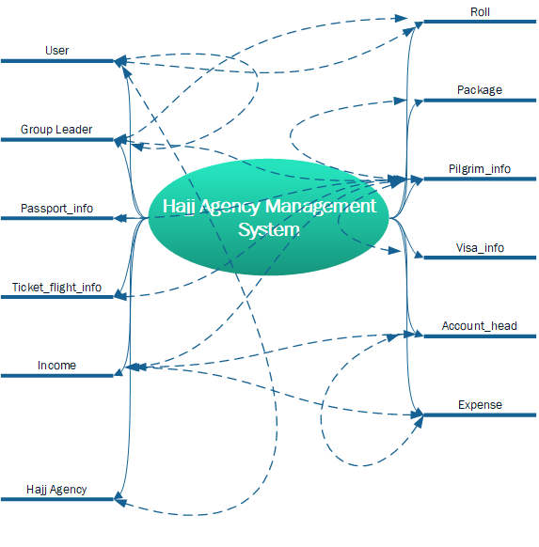
Brain Storming Diagram

Slide 6
Use Case Diagram

Slide 7
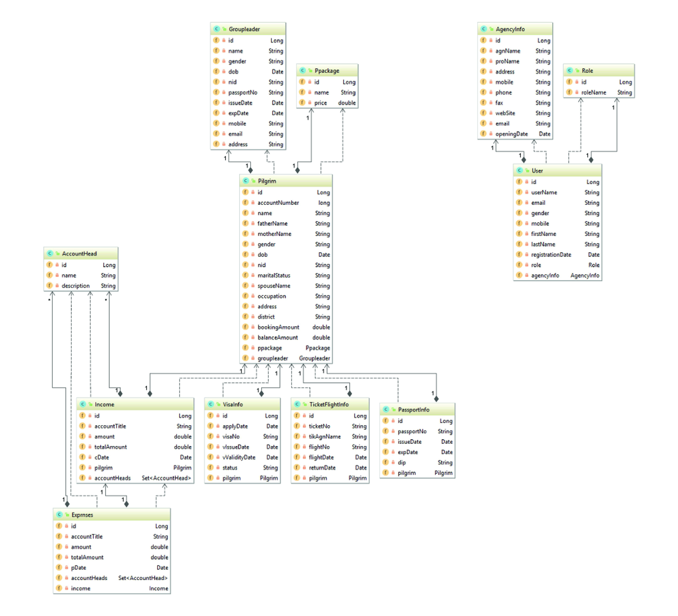
Entity Class Diagram

Slide 8
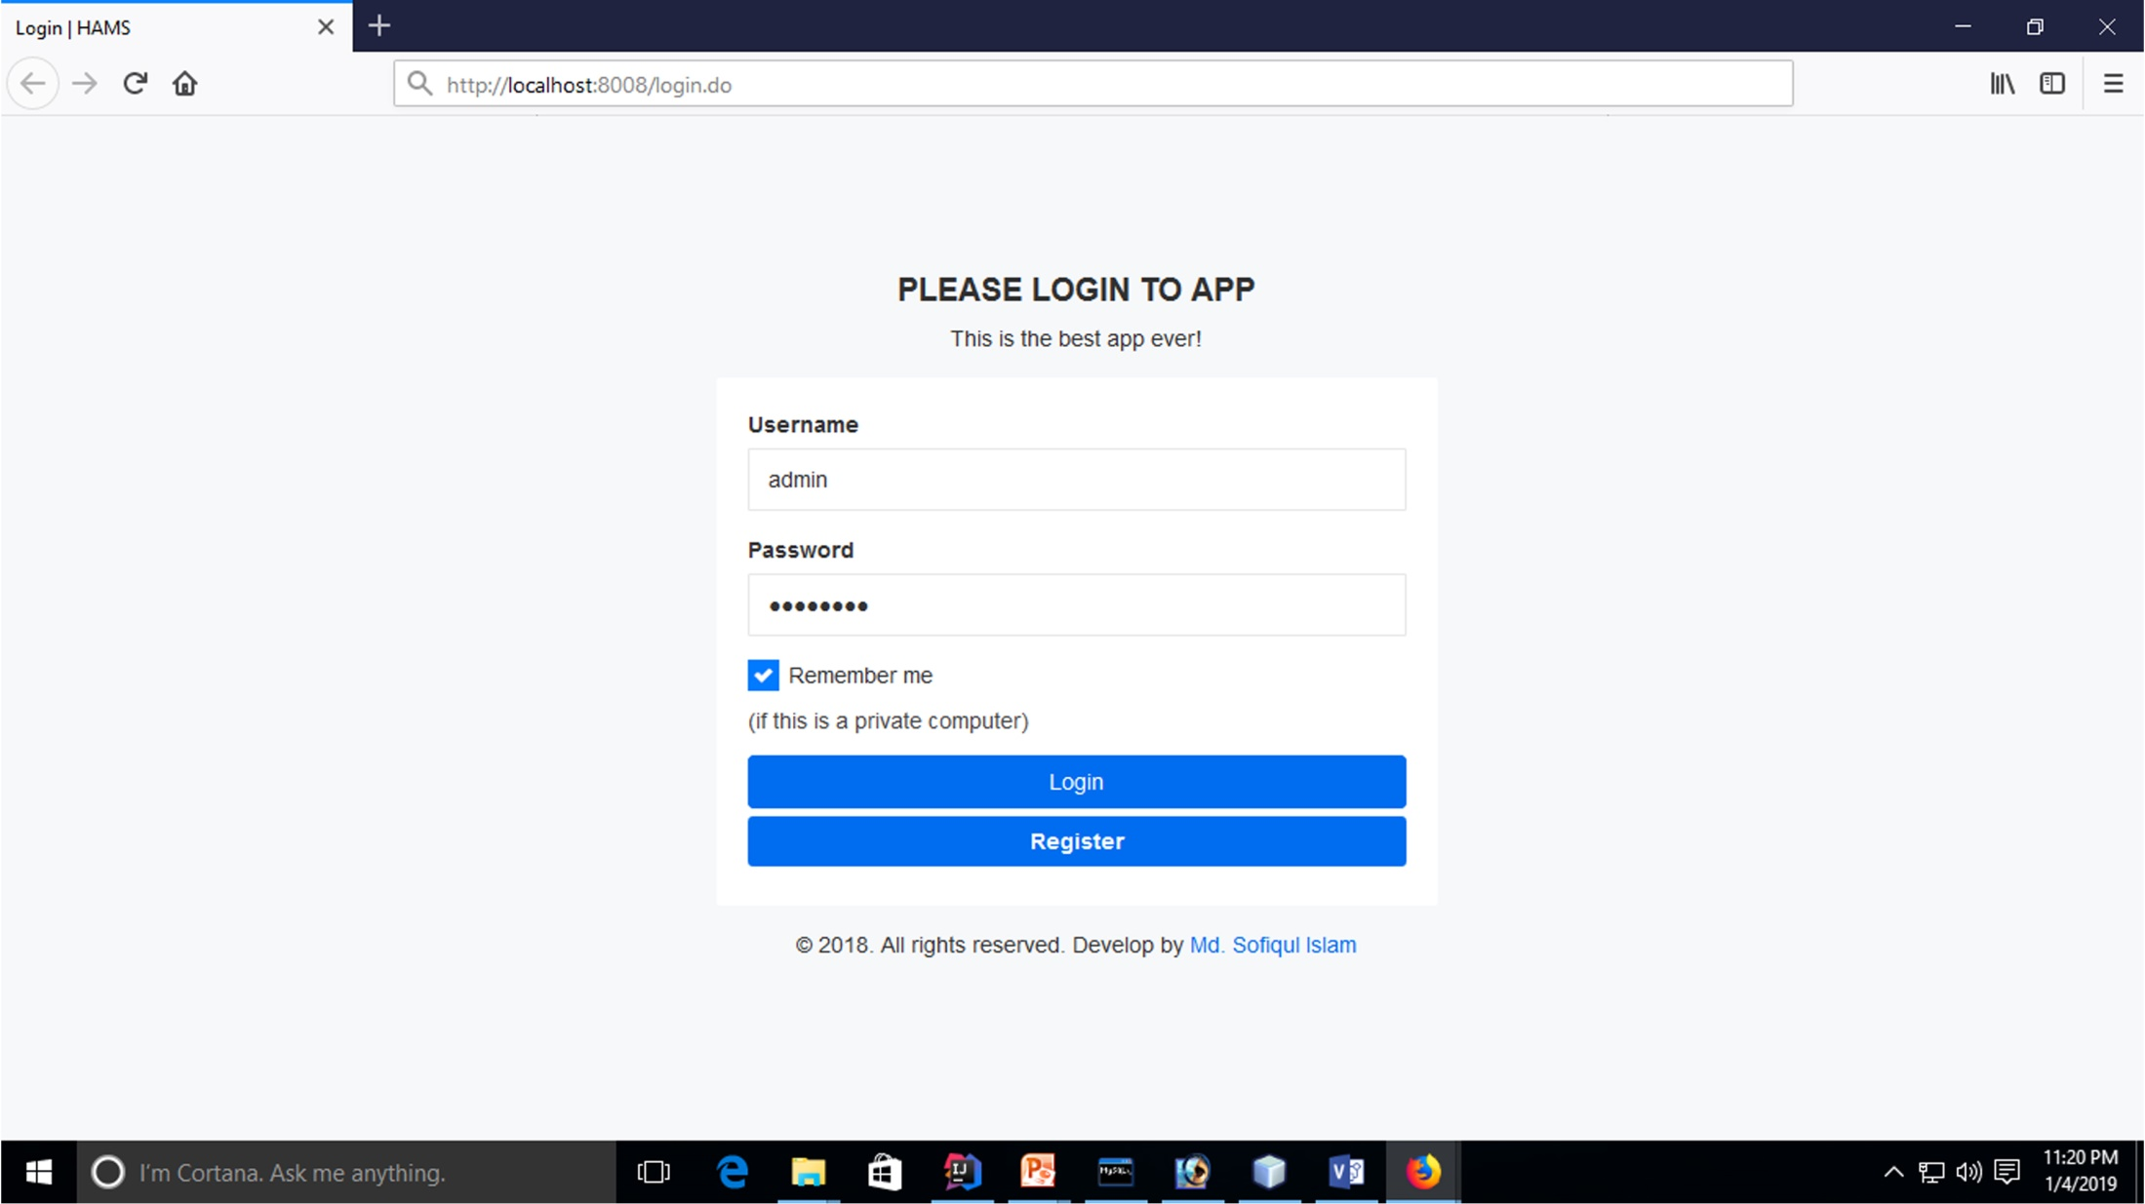
Application Screenshot
Login Page

Slide 9
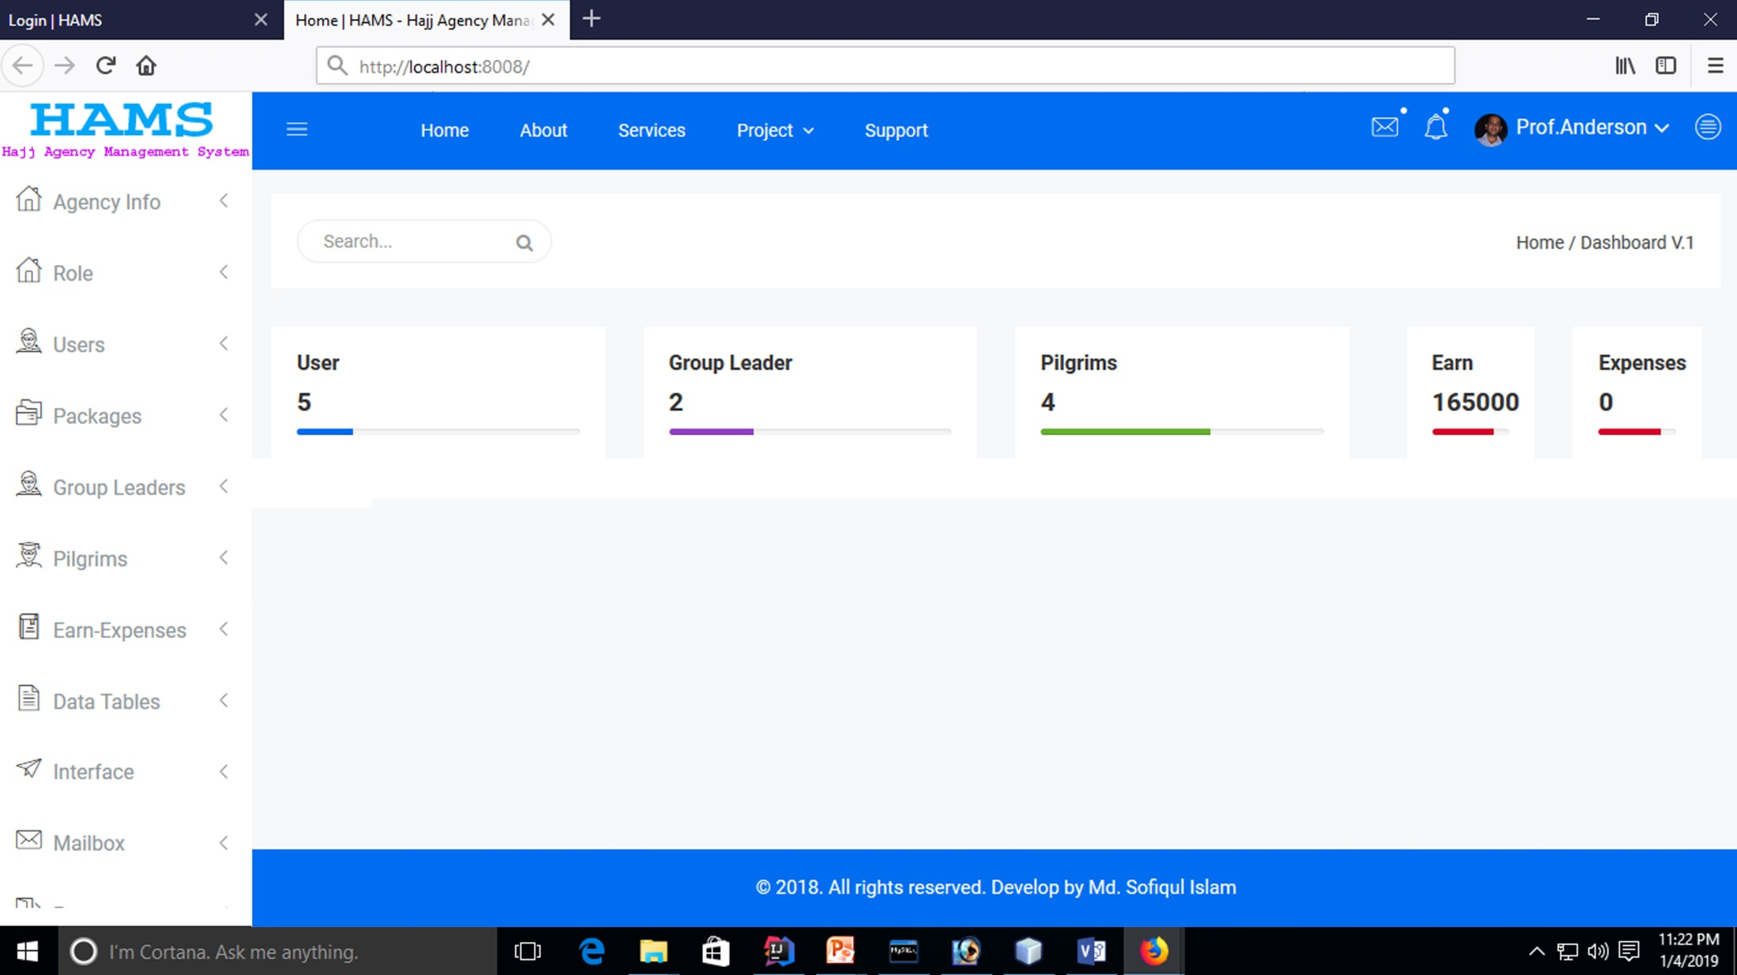
Dashboard

Slide 10
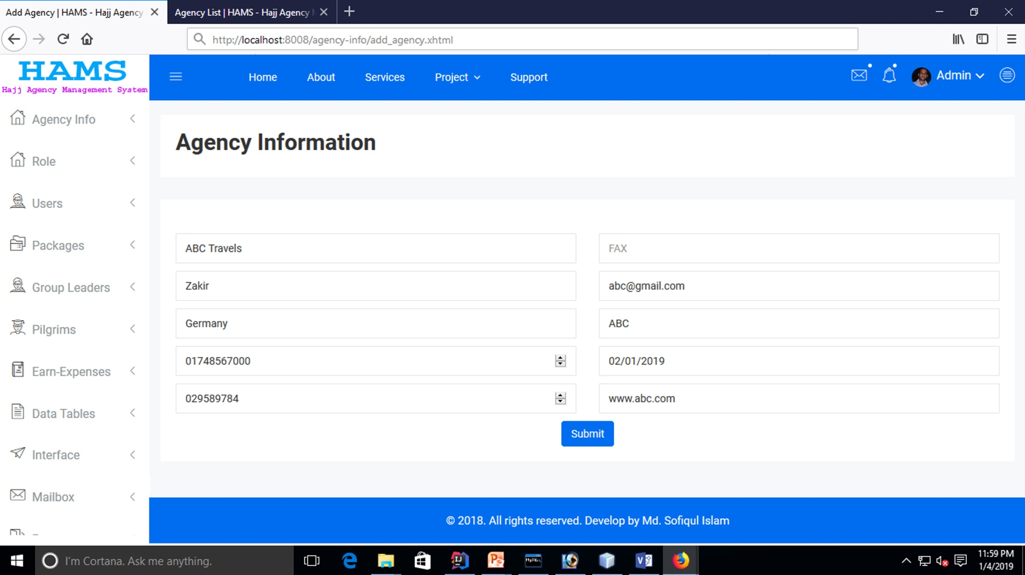
Add Agency Info

Slide 11
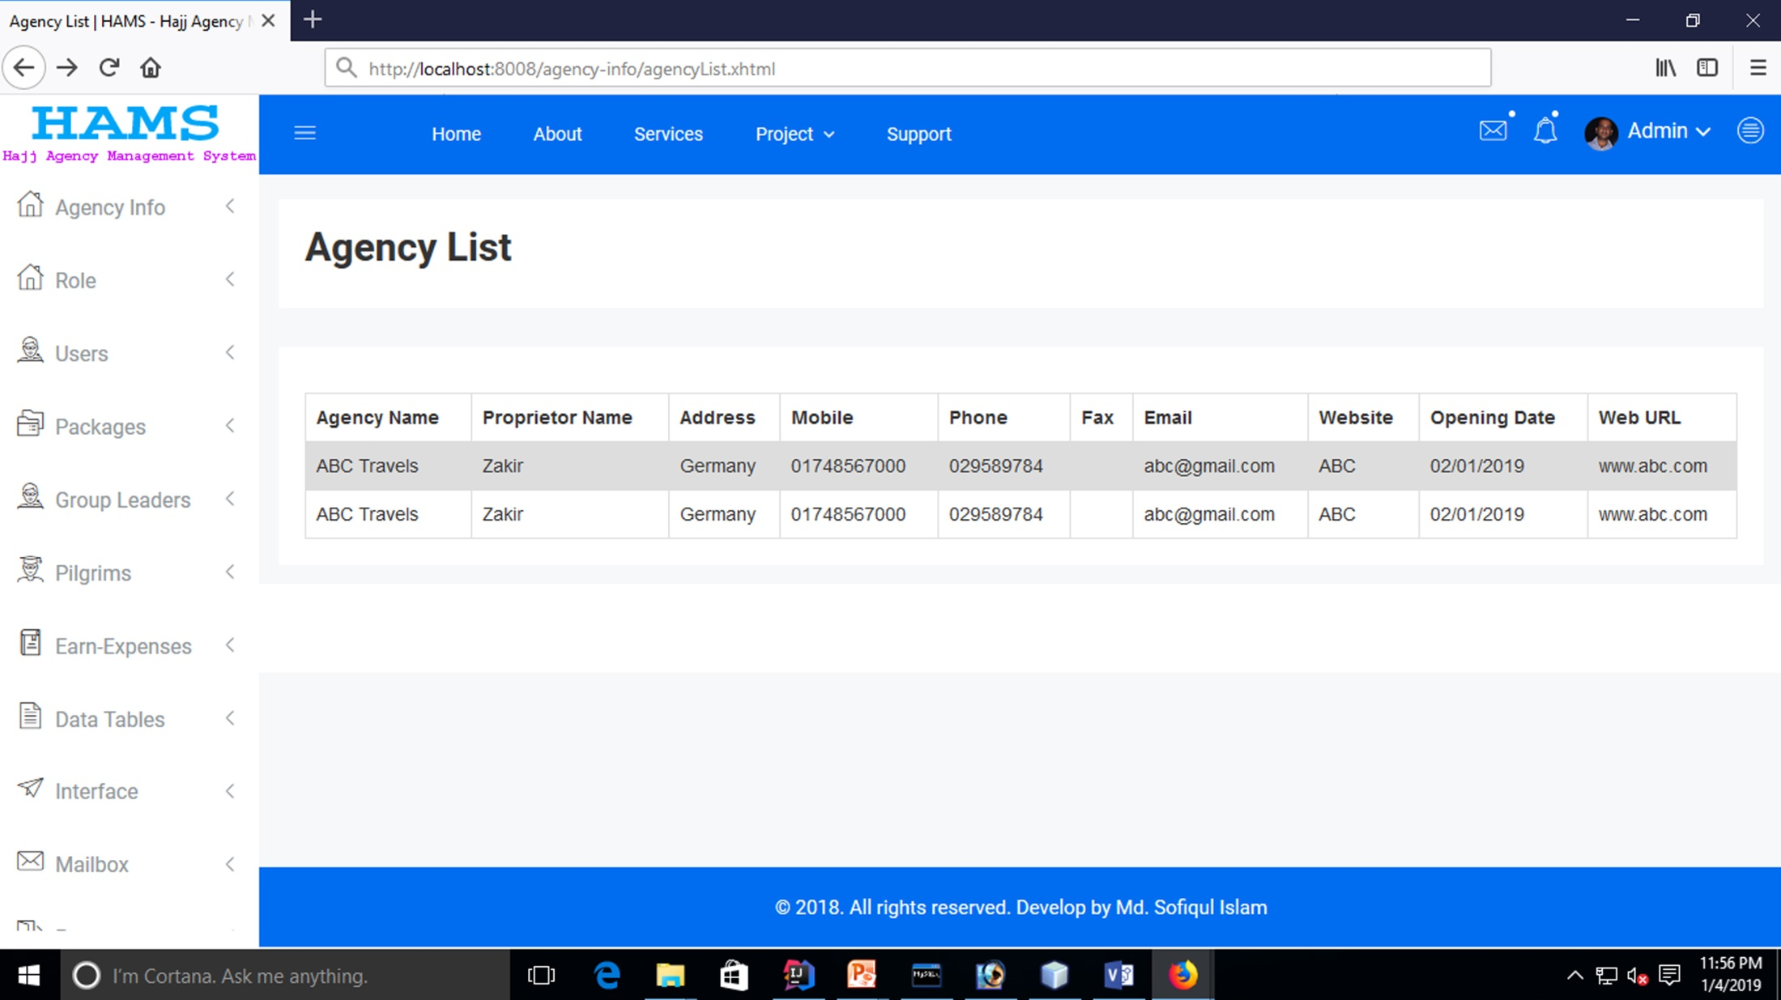
Agency List

Slide 12
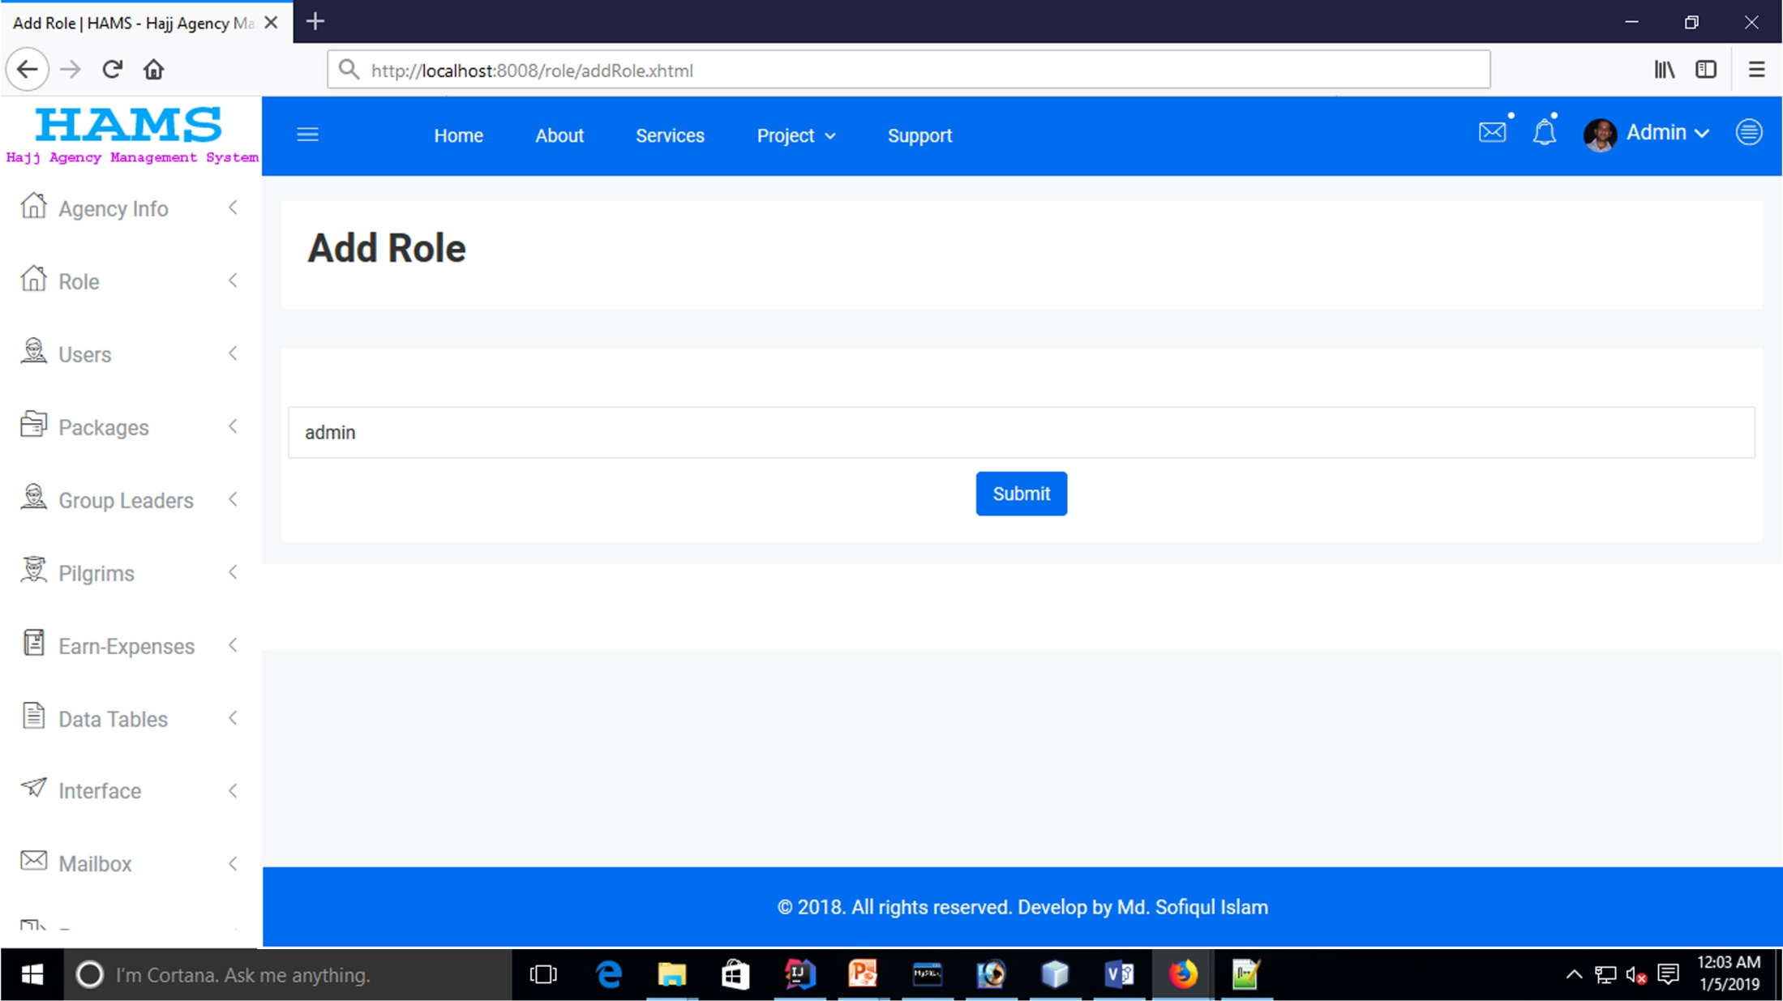
Add Role

Slide 13
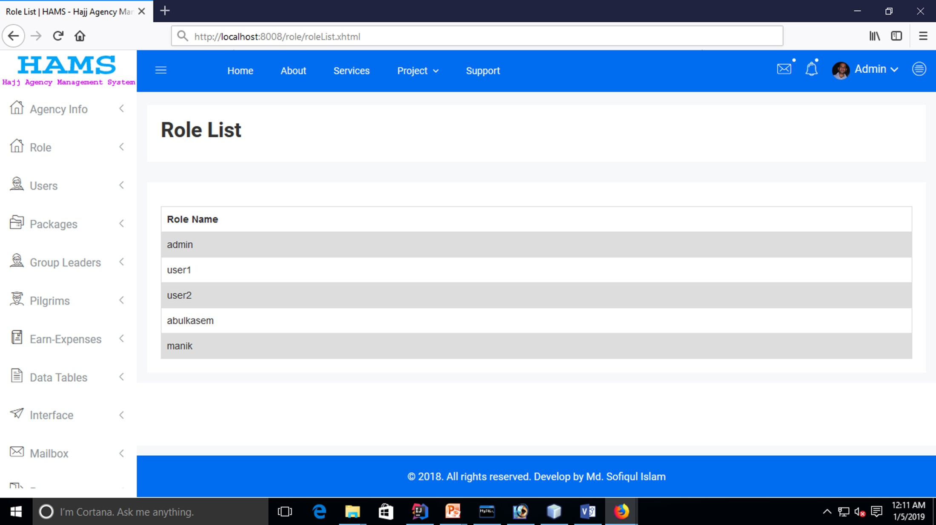
Role List

Slide 14
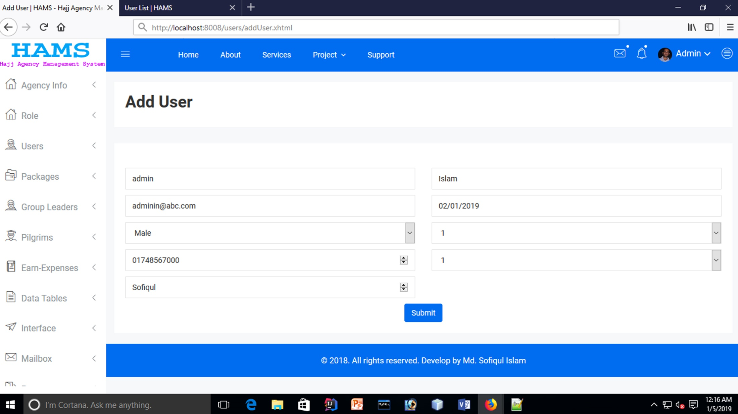
Add User

Slide 15
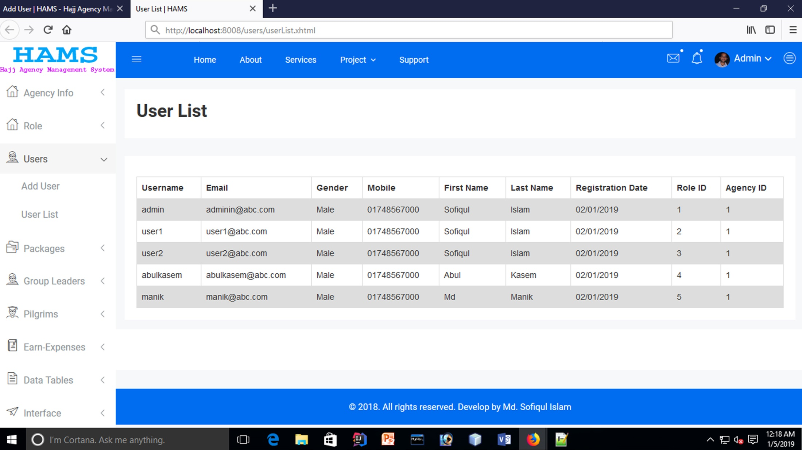
User List

Slide 16
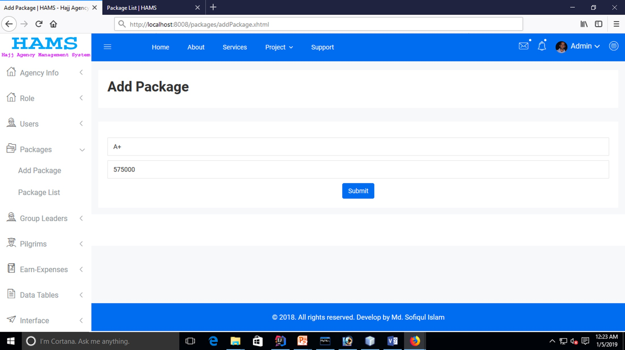
Add Hajj Package

Slide 17
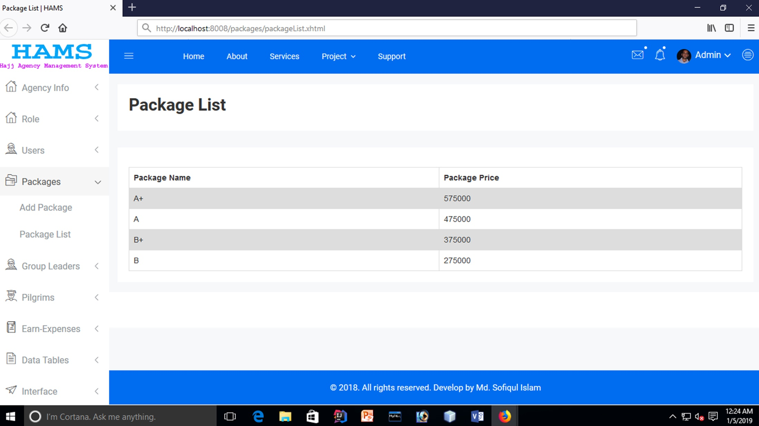
Package List

Slide 18
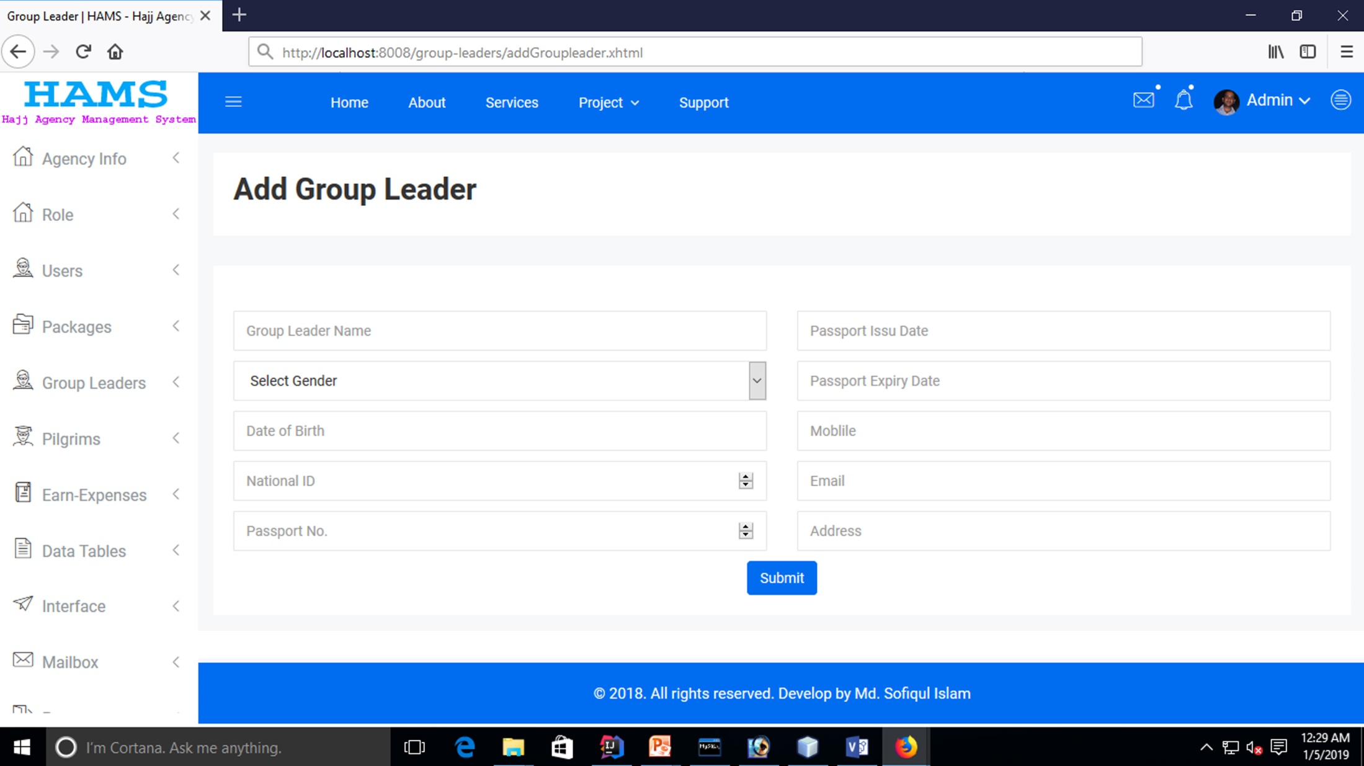
Add Group Leader

Slide 19
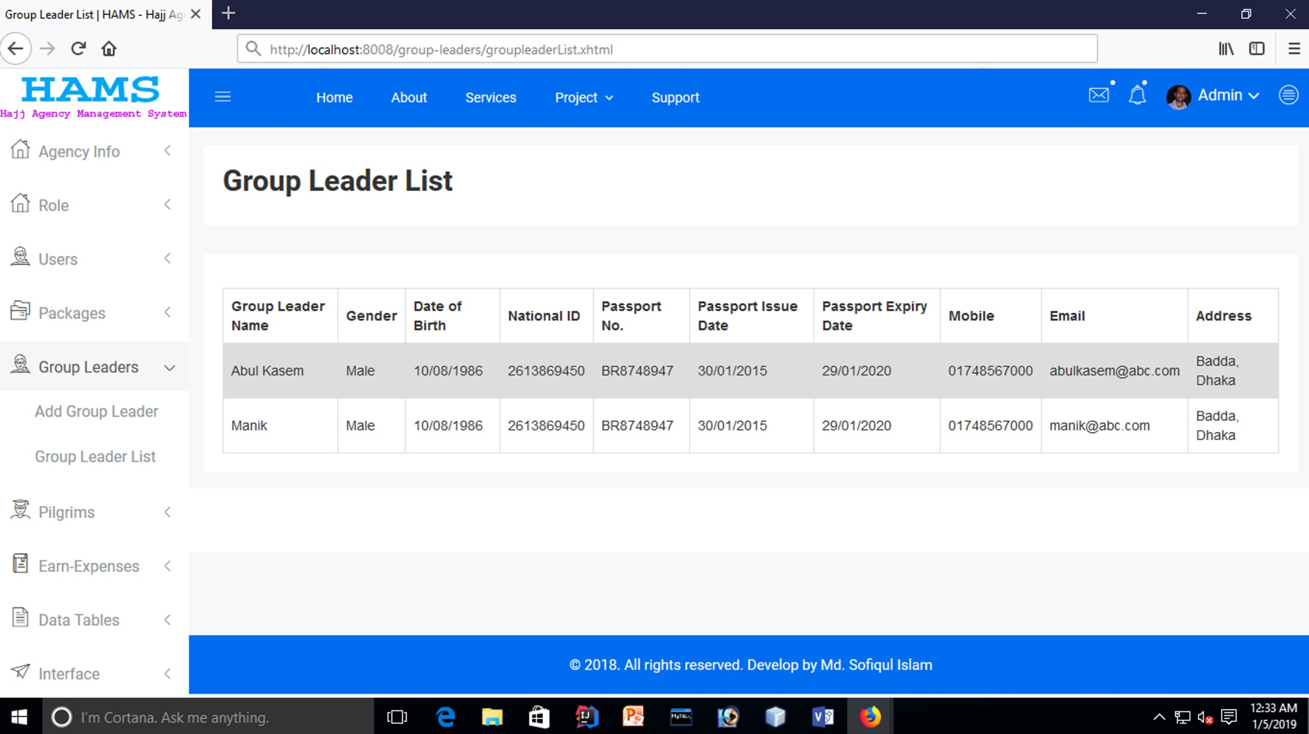
Group Leader List

Slide 20
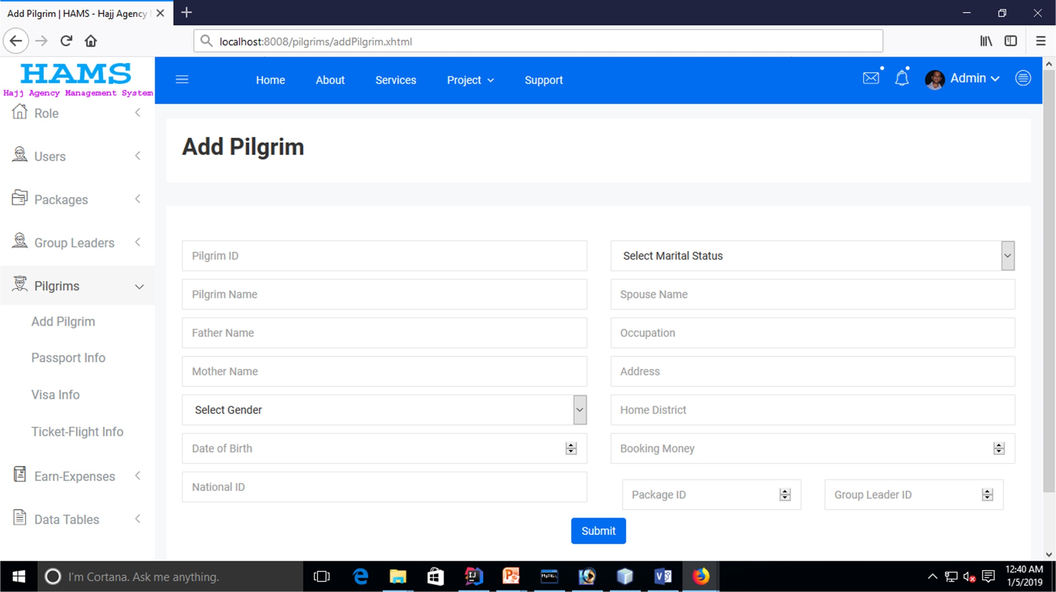
Add Pilgrim Blank Page

Slide 21
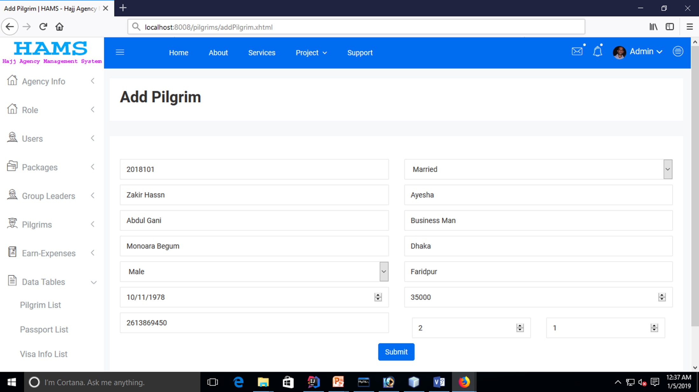
Add Pilgrim

Slide 22
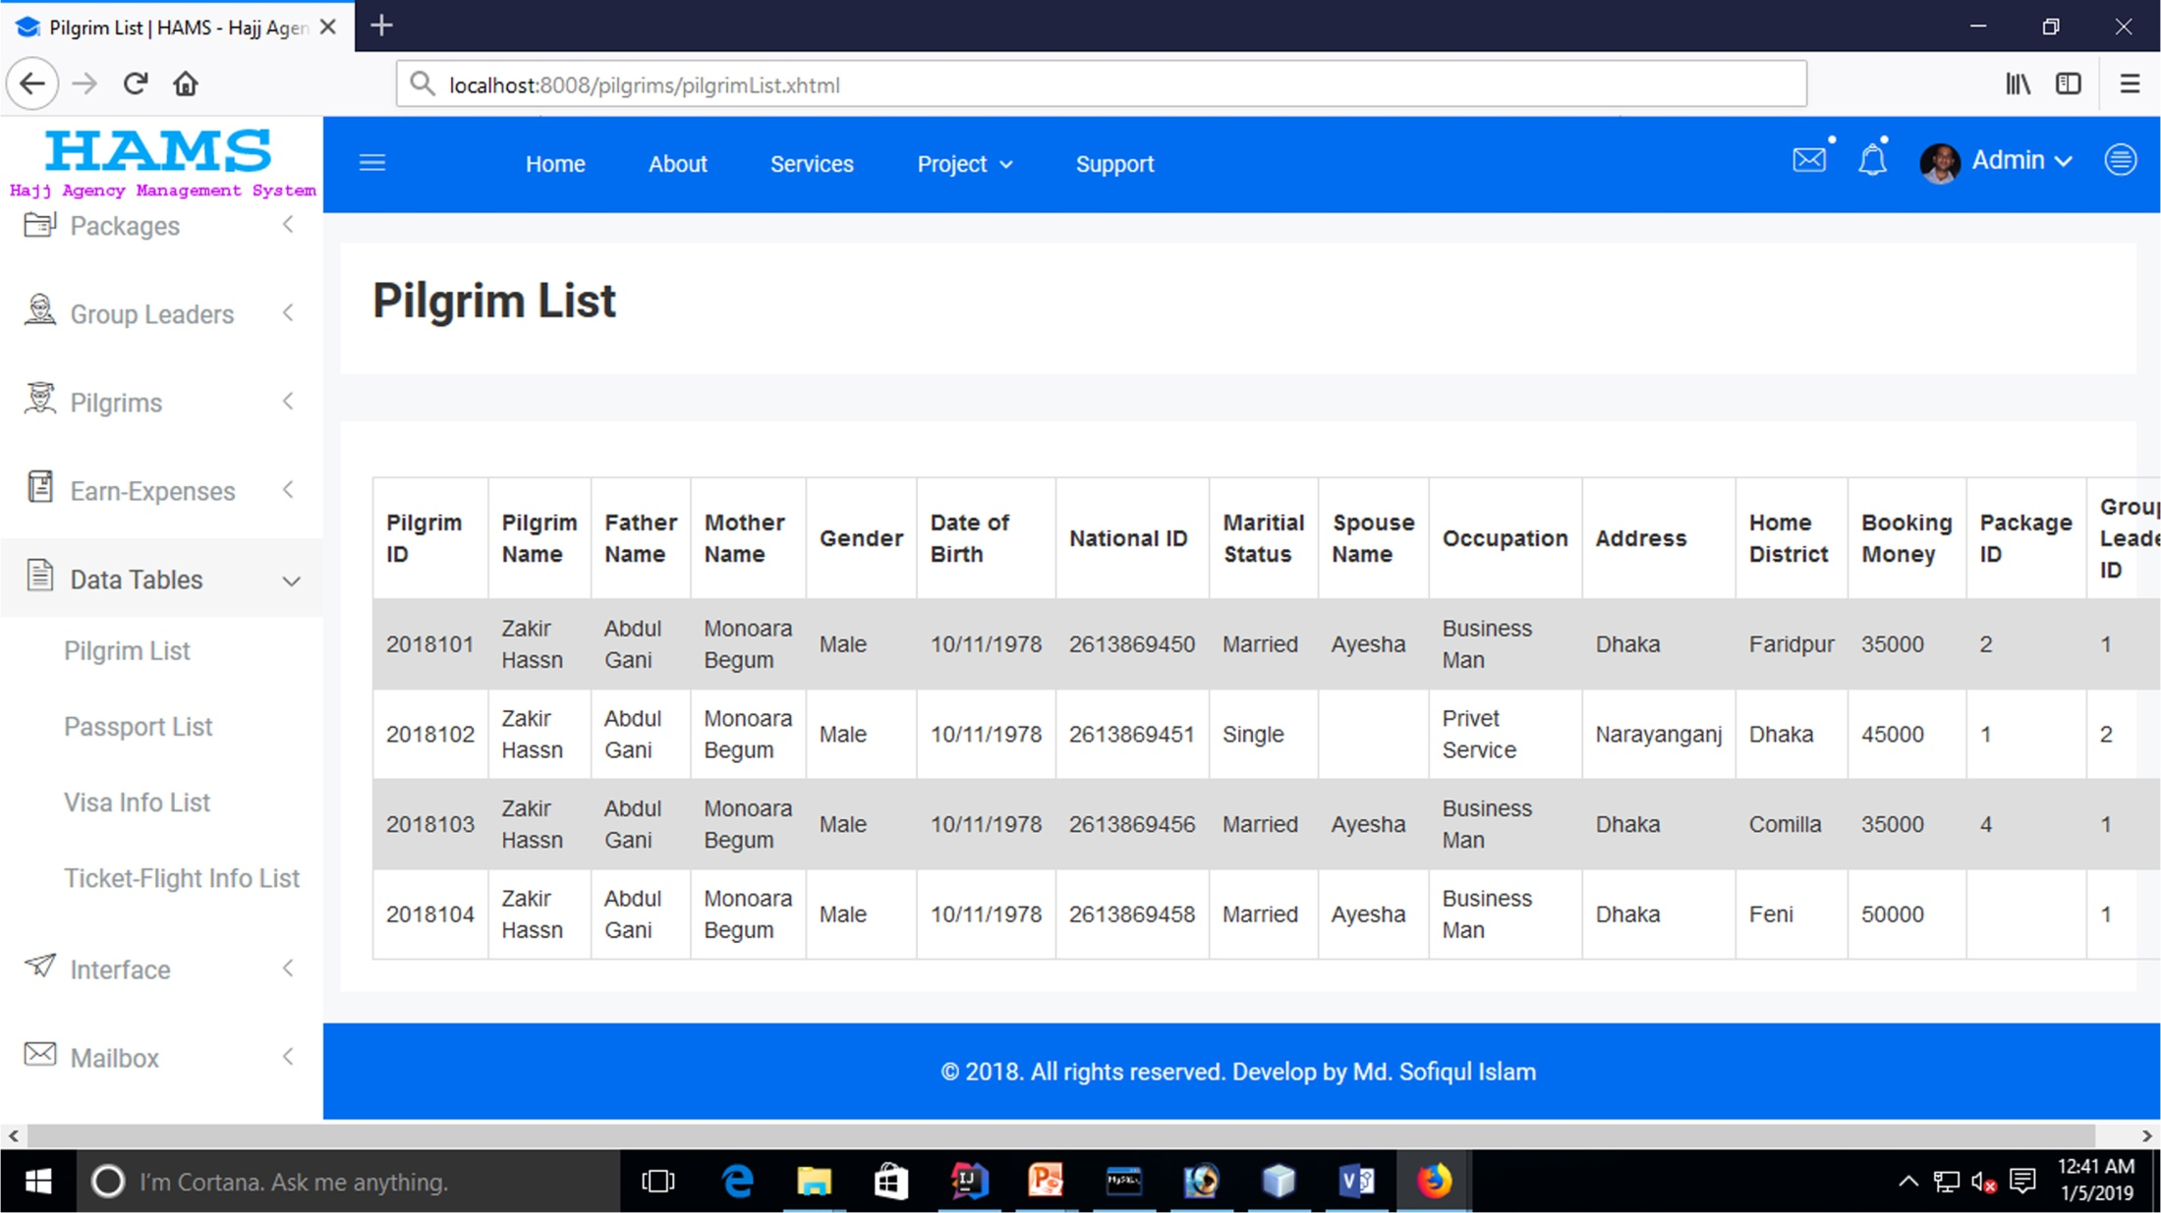
Pilgrim List

Slide 23
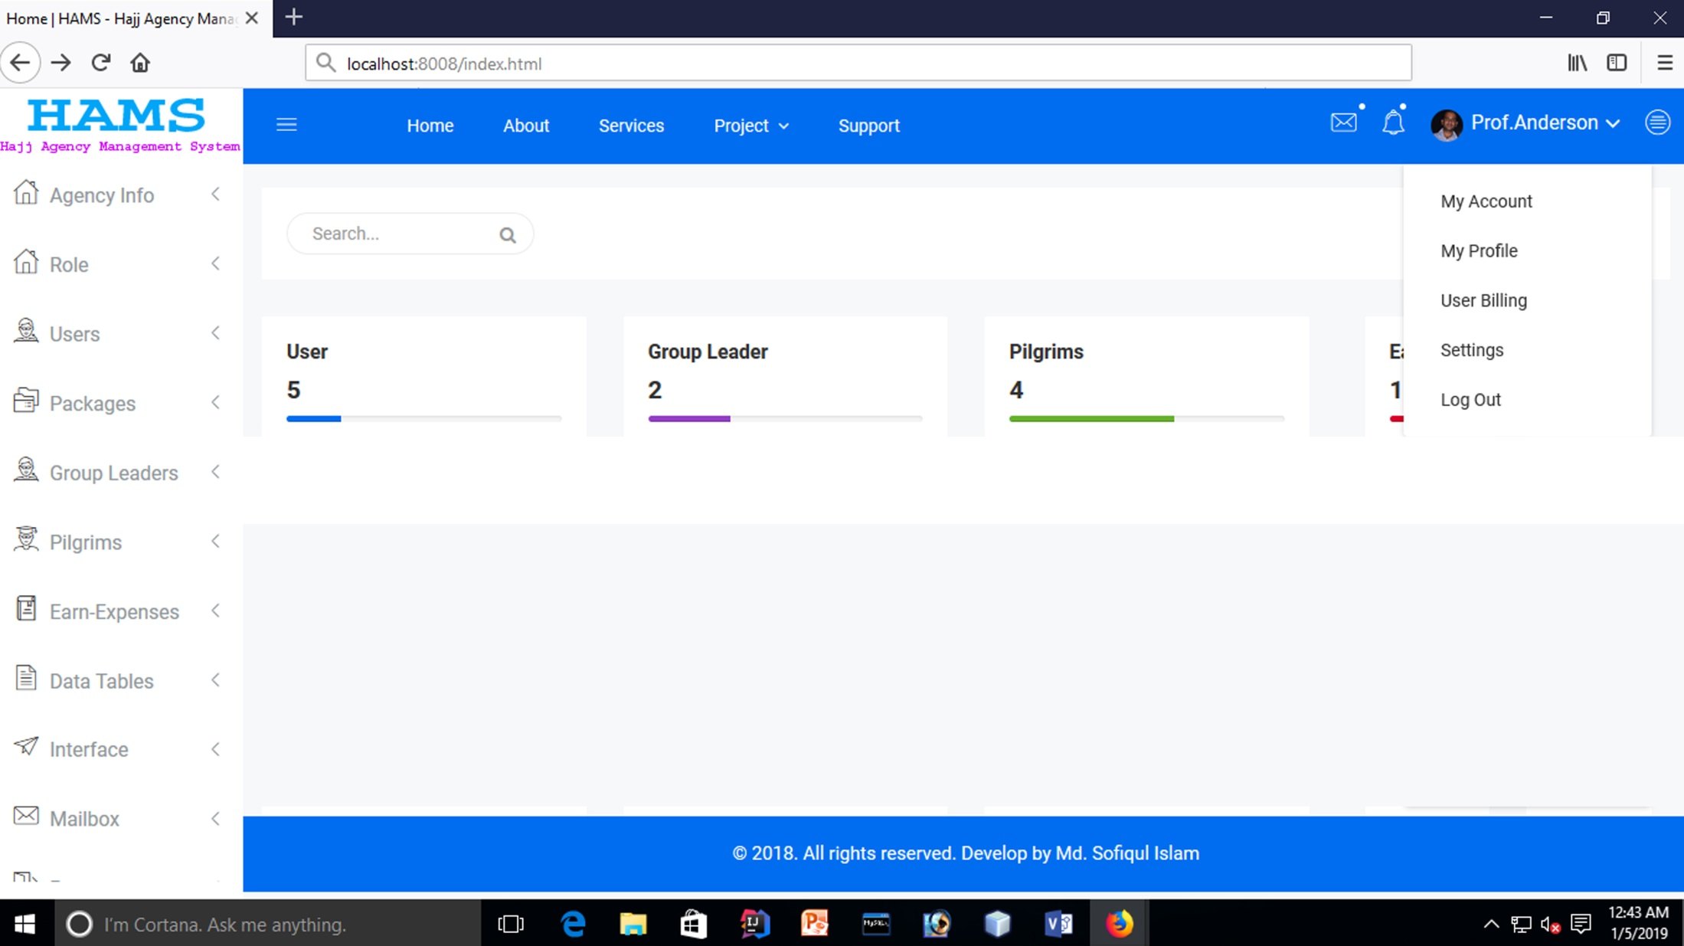
Logout

Slide 24
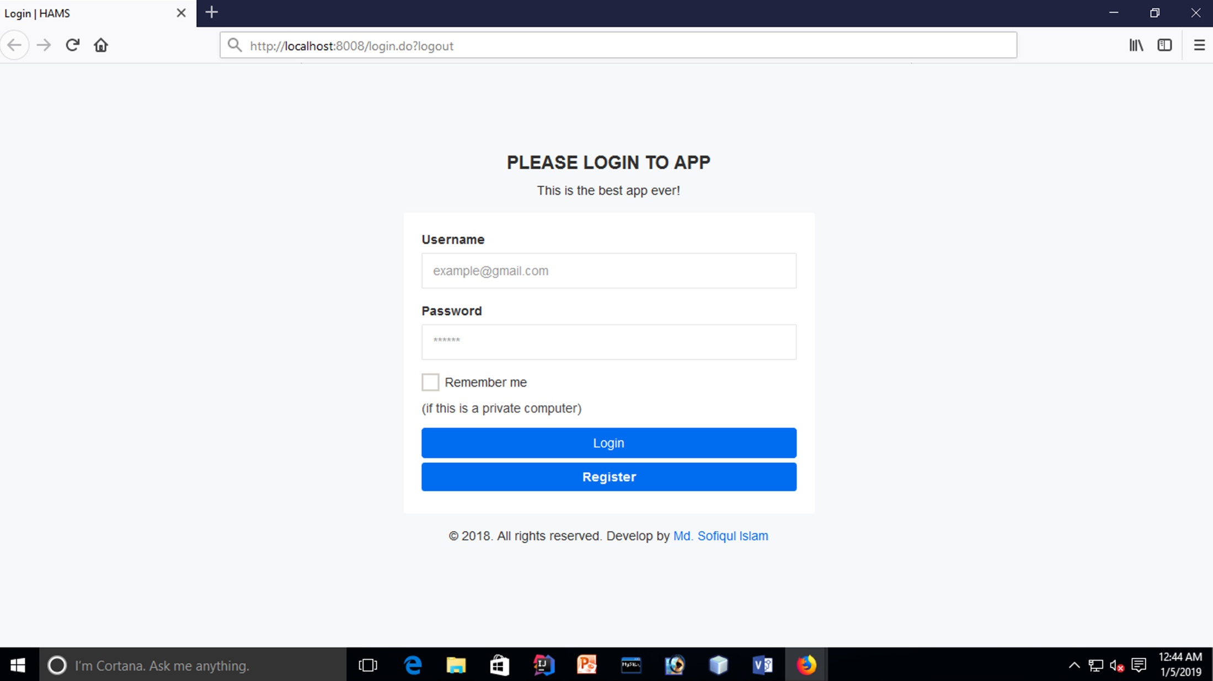
Redirect to Login Page

Slide 25
Thank You

